Slide 1
University of Exeter DClinPsy Open Day 2023 Introduction to Clinical Module
Dr Tracy Rydin-Orwin
Clinical Practice Director

Slide 2
What is the Clinical Module?
Over 50% of the training
3 years of supervised placements with Clinical Psychologists & other appropriately qualified professionals
An idiosyncratic journey through a relationship-based education in real world settings
Competency based:
BPS Standards for Doctoral Programmes in Clinical Psychology, 2014
HCPC Standards of Education and Training Guidance

Slide 3
What is the Clinical Module?
The opportunity to make a meaningful positive difference in the lives of others from your first clinical placement and to learn how to do that better every day…

Slide 4
Where do placements take place?
Mid-, East and North Devon: Devon Partnership Trust
Throughout Dorset: Dorset Healthcare NHS Trust
Throughout Somerset: Somerset NHS Foundation Trust
Also with county councils & a range of third sector, charities and private providers
Exciting new partnership with Healios an online psychology provider

Slide 5
How are placement bases allocated?
At point of being offered place on course you will be asked for your placement-base preference (Devon, Somerset or Dorset)
County bases allocated according to preference and availability
Placements will be at various locations within your base county
Important to consider relocation & how you get to/around on placement

Slide 6
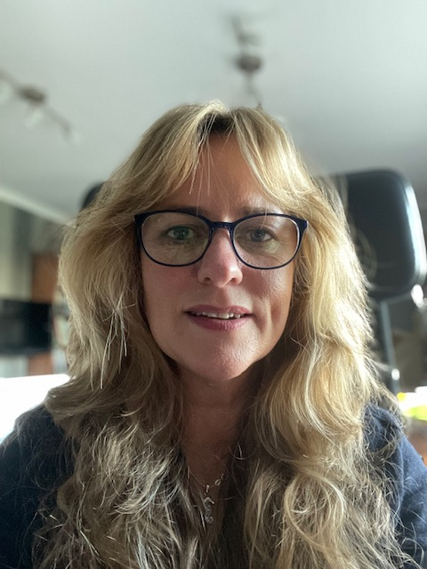
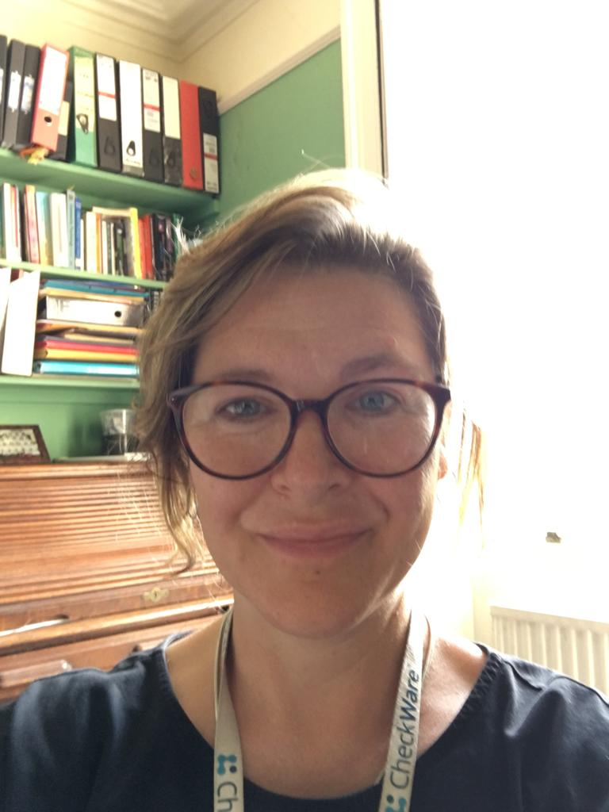
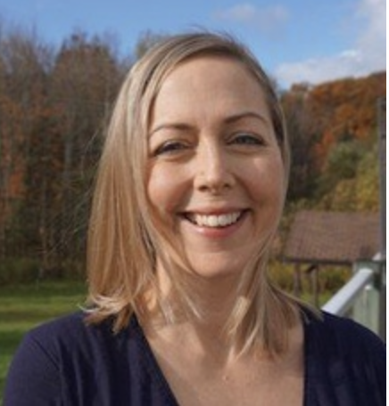
Meet the Clinical Team…
Dr Tracy Rydin-Orwin
Clinical Practice Director
T.J.Rydin-Orwin@exeter.ac.uk
Tutor for Somerset
Dr Anna Kidd
Tutor for Dorset
A.Kidd@exeter.ac.uk
Magdalena Katomeri
Programme Manager
DClinPsy@exeter.ac.uk
+44 (0) 1392 725762
Dr Alexis Clarke
Clinical Tutor for Devon
A.Clarke8@exeter.ac.uk
Notes:
6

Slide 7
How are trainees supported?
Clinical Tutors (for Devon/Dorset/Somerset):
Get to know Trainees, their experiences & interests
Plan and allocate placements
Meet with Trainees & Supervisors
Provide Clinical Tutorials
Offer ongoing support with placement issues
Walk through the clinical journey alongside you…
Notes:
6

Slide 8
What Placements will I have?
Child
Adult/Older Adult
Specialist Therapeutic Modalities...
Learning Disabilities
Neuro
Health
Forensic
Other specialties...

Slide 9
Competencies not Specialities
Experience: Trainees are expected to develop their competence through a balanced range of experiences across settings and client groups. The BPS and HCPC specify the range of experience required in clinical psychology training:
Exposure to clients, carers and families with a range of presenting problems, resources and abilities across the life span, based in a range of service delivery systems or settings, working at a number of different levels (direct, indirect, and within multi-disciplinary teams) and using and integrating more than one psychological approach.
Each trainees experience will be unique!

Slide 10
Broad Placement Structure
Year 1 & 2
Children & Young People / Learning Disabilities / Neurodiversity / Health /Adults through the life span
Year 3
Consolidation
Preparation for qualified practice
Specialisation

Slide 11
University of Exeter DClinPsy Innovations
Competency-based placements
Online paperwork collaborations
Opportunities to build contemporary CP competencies e.g. online working through Healios
Enhanced opportunities for secondary accreditation in CBT, Systemic & CAT.
Enhanced support for supervisors to support trainees e.g. training in anti-racism (& in other areas of diversity & difference)

